Slide 1
Welcome to React the Definitive Beginner’s Guide
Rami Sayar
Jeremy Foster

Slide 2
Agenda - list all main modules
1
Welcome to React – the Definitive Beginner’s Guide
2
Introduction to Components
3
Handling Data and State with React
4
More React with Routers and Other Add-ons
5
ES2015 with React, Webpack, and Other Tools
6
Connecting Pizza Box App with the Backend

Slide 3
Module 2: Introduction to Components
Rami Sayar
Jeremy Foster

Slide 4
What are components and web components?

Slide 5
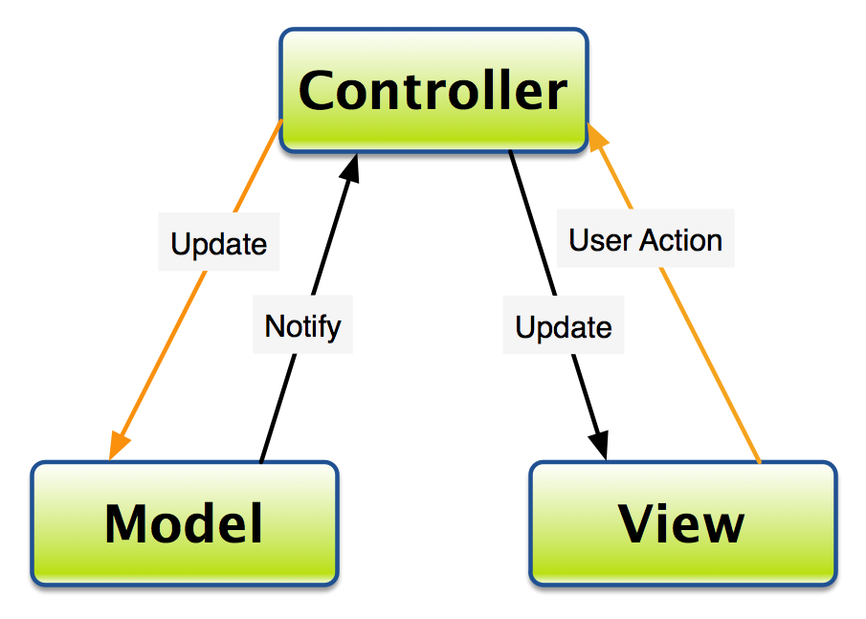
How does it relate to MVC?

Slide 6
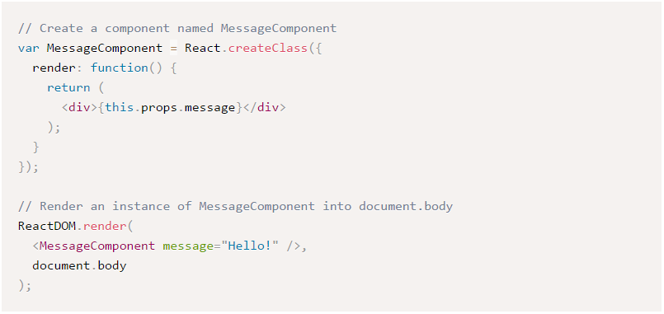
Introduction to React components

Slide 7
What is JSX? And how can I not use JSX?

Slide 8
JSX

Slide 9
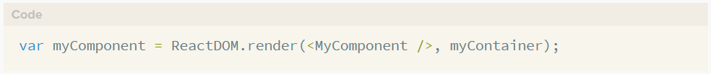
refs

Slide 10
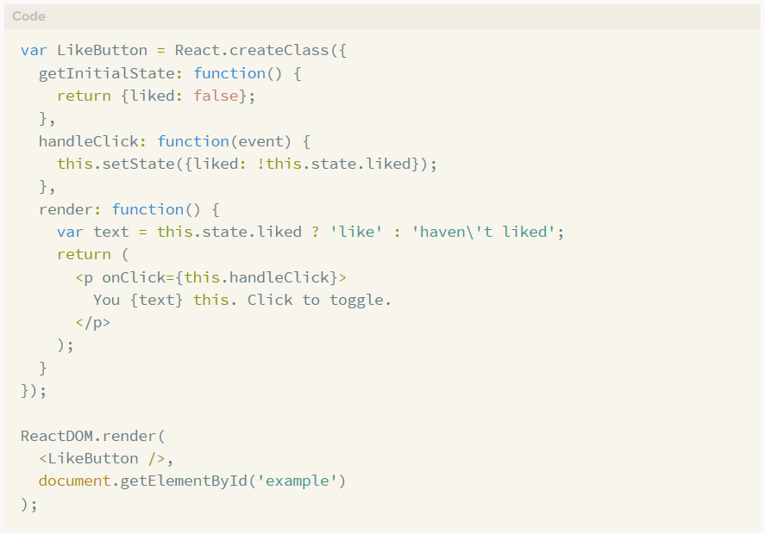
Interactivity and dynamic UIs

Slide 11
Building the first React component in the app

Slide 12
Building the App, InboxPane, and InboxItem components

Slide 13
Styling components

Slide 14
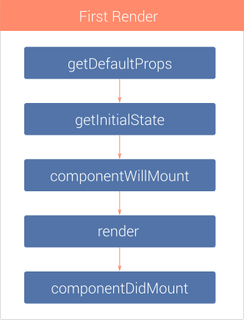
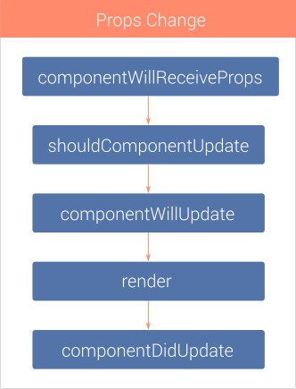
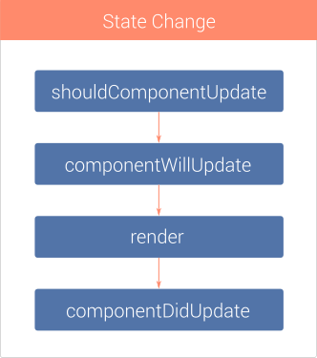
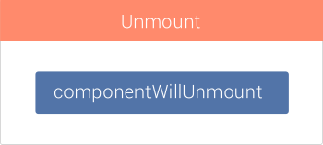
The component lifecycle

